Slide 1
Gateway Ordering Phase 3 Delivery Approach
Prioritization, Planning, and Deployment Analysis
April 2016

Slide 2
Background & Context
Gateway Ordering Phase 3 introduces support of “Existing Customer” ordering scenarios
Complexity of Offers and Buy Flows require specialized capabilities independent of the UI
Quote persistence and retrieval prior to order submission to Biller Isolation
Pricing Engine that can support complex qualification and calculation methods for both Gateway Ordering and E-Commerce channels
Work Flow manager supporting order state management, business rules, and activity sequencing for multiple buy flows
The data needs for user display and buy flow scenario processing are extensive and the Phase 2 data models need to be extended
Requires a “MEC view” of Accounts and Orders (vs. “Biller view” in Gateway Dashboard, DM, etc.) to be “Reverse Translated” prior to Ordering
Increases reliance on Biller Isolation capabilities from Solo DB, RDM, Enterprise Services, and JESI
The Phase 3 Delivery Approach needs to be carefully considered prior to detailed design and development to align all impacted stakeholders

Slide 3
Approach 1 – Functionality Focus
Key Principles
Primary goal is to deliver functionality to the users as soon as possible
Data elements and supporting capabilities to be defined and delivered at the time needed to deliver incremental UI functionality
Technical Debt incurred where warranted to accelerate delivery of functionality
Pros
Incremental functionality made available earlier in program lifecycle
Aligns with Charter budgeting and project management methodology
Cons
Functionality delivered may not meet all requirements due to capability gaps
Increased rework in subsequent cycles to incorporate new functions
Technical debt rarely gets solved

Slide 4
Approach 2 – Capability Focus
Key Principles
Capability-based services are an underlying tenet of Charter’s Application Architecture strategy
Primary goal is to build technical capabilities that provide a strong foundation for subsequent rapid deployment of functionality
Capabilities to be delivered by dedicated teams based on high level understanding of the needs of multiple potential consuming projects
Pros
Improves ability to deliver solutions for high complexity requirements
Provides a framework to apply the right tools and technologies to different problems
Enables multiple consumers / channels to leverage common capability with a consistent implementation & interpretation
Enables rapid functional delivery based on reusable components once base capability is deployed
Capability testing independent and in advance of functional implementation
Aligned with Charter Application Architecture strategic roadmap
Cons
Requires up front investment with minimal production-ready functionality delivered early in the program
Requires a change to Charter’s project budget allocation, delivery organization(s), testing, and management processes

Slide 5
Recommendation
The Capability Focus Approach best aligns with Charter’s long term vision and requirements for Ordering
Supports common delivery of Gateway Ordering and E-Commerce roadmap items including:
Serviceability
MEC Integration
Multi-Biller Integration
Complex Order scenarios (SB, MDU, Upgrades, etc.)
Recognizes the Operational and Technical complexity of Order Capture processes and structures the Delivery teams accordingly
GO Phase 1 attempted “quick win” Functional approach, but was never deemed Production ready
Increased complexity of future GO phases only increase the risk with functional focus approach

Slide 6
Appendix
Key Capability Summary
Capability Dependency Tasks
Gateway Ordering Functional Dependency Map
Phase 3 High Level Reverse Translation Process
Gateway Ordering Functionality Summary
Documentation Lifecycle

Slide 7
Key Capabilities
Biller to MEC Account and Order Reverse Translation
Existing Gateway Stack Enhancements & Conformation
Biller Common Order Specification Integration
Pricing Engine
Serviceability Enhancements
Application/Transaction Persistence & Retrieval
Event Definition & Management
Functional Biller Isolation
Workflow Management Engine
Content Management System Integration
Operational Reporting

Slide 8
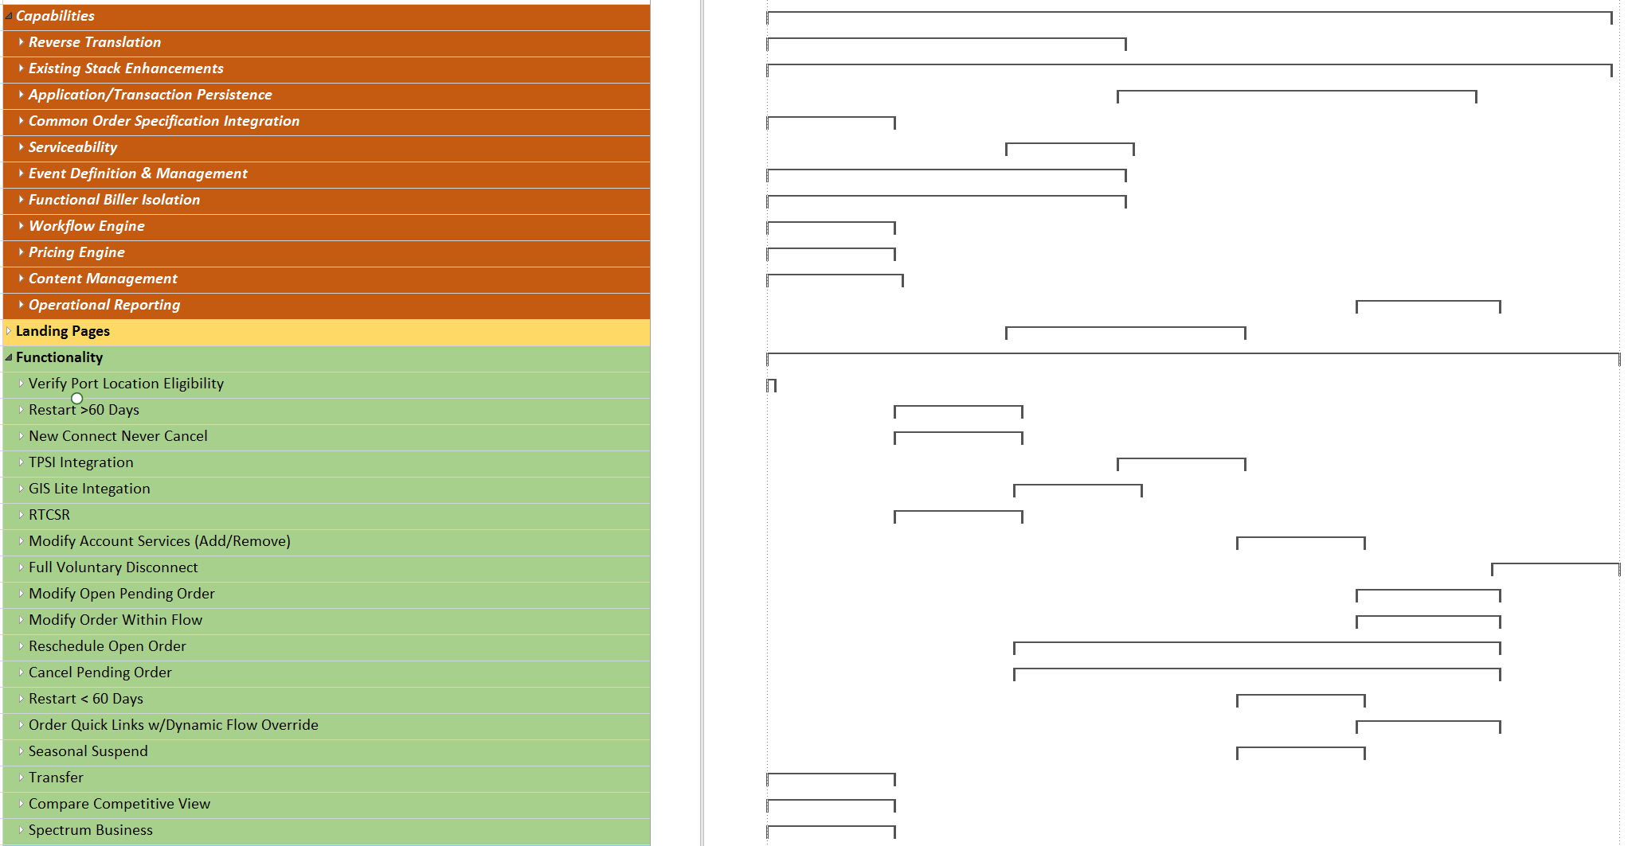
Capability Dependency Tasks
Relative complexity (# of sub-tasks)

Slide 9
Gateway Ordering Functional Dependency Map

Slide 10

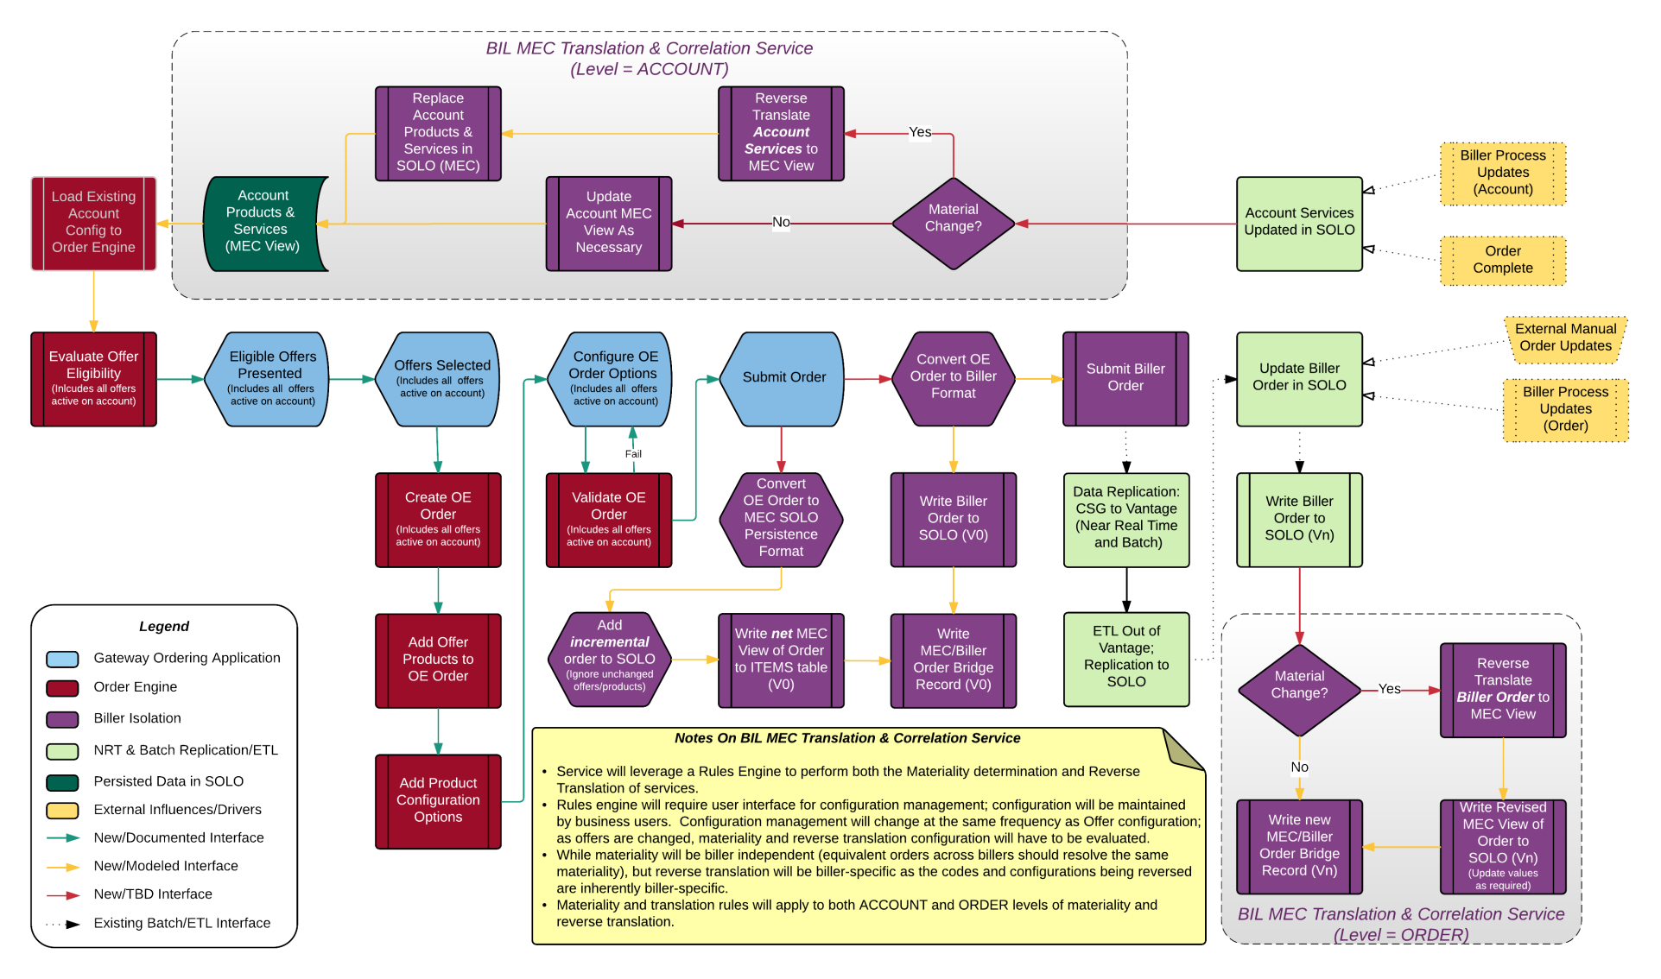
Ordering and Reverse Translation Process Flow
Gateway Ordering Landing Page & Buy Flow Router

Slide 11
Gateway Ordering Functional Summary (Pt 1)
Process Area | Open | Tech | Comments
1. 2.x Stabilization and Re-work | Low | Low
1a. CR41 overflow and additional items | N/A | High | COS dependency, net new to all departments.
1b. Release unused TNs | Medium | Medium
1c. Verify LEC Port Location | High | Medium
1d. Tech debt payment | N/A | N/A
1e. New good ideas (CRs) | N/A | N/A
2. RDM integration
2a. Order Reasons, Cancel Reasons, and Salutations | High | High | Persistence, Tech Debt
2b. Dwell Type, Phone Type | High | High | MEC + Data integration
2c. Service, Package, Discount, Enterprise Codes | High | Medium | JESI and MEC
3. Restart > 60 Days | High | Low | No landing page required, go directly to the customer. SOLO/JESI mapping and service changes.
4. Restart Never Cancel customers | High | Low | No landing page required, go directly to the customer. SOLO/JESI mapping and service changes.
5. TPSI, (Triple Play (actually all types of ‘plays’) Self-Installs) UI Flow Changes – figure out how to skip over schedule with Office only type flags based on offer choices that are made by the CSR | High | Medium | Configuration, compatibility, and eligibility rules - this will be included on the Offer Customization screen. MEC/UI/Sched
6. GIS Lite Integration | High | Low | Address search and serviceability, from a GIS Lite integration it will be on a Low/Medium side because there's an API that can be called. Not an ordering functionality, needs to be given to CRM or PMBI (John Williams).
6a. Search
7. RT CSR Integration
7a. Vendor Integration | High | Medium | No Vendor has been selected, vendor risk/new API
7b. UI Flow integration and MEC configuration | High | Medium | Medium/high, this is regarding status mapping and logic (return colors based on data)
7c. Provisioning data flow updates | High | High | Getting new fields built in CSG, sodi enabled, nextgen interpretting them correctly, etc.
8. Current Acct. Services Landing Page | Medium | High | Risk of testing and the entire stack must work together.
9. Disconnect Account Last Services Landing Page | Medium | High
10. Open Order Services Landing Page | Medium | High
11. Order History Summary Landing Page | Medium | Medium | Minor SOLO and UI Services
12. Order History Detail and Services Page | Medium | High | Reverse Translation, Services, and UI
13. Modify (Add/Remove) – Change of Service | Medium | High | Reverse Translation and COS
13a. Port out
14. Disconnect Buy Flow (Voluntary) | Medium | Low | *Flow only = Ops may need Reverse Translation
14a. Port out
15. Modify of Open Pending Order | Medium | High | Very difficult, Reverse Translation, COS, UI Flow, Delta un-Bucketing logic
15a. Offer Issue
16. Modify Order within the Flow (after point of no return, be able to update order – today we have to go to ACSR to do this) | Medium | Medium | Persistence (i.e., saving data so that when you select the Back button the information will be there when you return), UI *Assumes initial order in OE/UI
17. Reschedule a Pending Order | Medium | Medium | COS/UI, assumes no Reverse Translation, Reschedule per Order Summary Low without COS.

Slide 12
Gateway Ordering Functional Summary (Pt 2)
18. Customer Requested Cancel a Open Order | Medium | Low | Assumes No Reverse Translation or COS, High assumest with Reverse Translation and COS
18a. Non pay cancel
19. Restart < 60 Days | Medium | High | Reverse Translation AH, COS, UI
20. Order Flow Quick Links | Medium | High | UI, Flow controller
20a. Dynamic Flow Override
21. Seasonal Suspend | Low | High | There are requirement changes coming for Seasonal Suspend. Reverse Translation, Account, COS
21a. Cost
21b. Set Dates
22. Transfers services to new location |  |  | Need to think about Identity Mgmt. requirements for Transfers, changes to come.
22a. In Market | Low | High | Reverse translation
22b. Out of Market | Low | High | Very difficult
22c. Biller | Low | High | Very difficult
23. Legacy Services compared to SPP
23a. Tool/Page to view | Low | High | Consider using competitive advantage tool (CAT), all net new functionality
23b. Auto transition | Low | High | Very difficult, UI/MEC
24. Spectrum Bus (Charter) | Defer
25. Operational Reporting (Logging) | Defer
26. Fallout Mgmt. | Defer
27. M+A | Defer
27a. ICOMS
27b. Ops/Call Centers
27c. Tech/Data
27d. Environments/DTC
27e. Small Bus.
27f. Additional/Products (Security)
28. Integration with Non-Order Flow | Medium | High | Persistence, Eventing, Data Model Integration
28a. Pref. Comm.
28b. RTCCA
28c. Content Mgmt. System

Slide 13
Documentation Deliverables Lifecycle
Application Requirements
Business Process Definitions
User Interface Wireframes
Business Analysis
Specific data elements requirements for presentation
Specific data elements required for application services
Functional Service Definition
High-Level Data Object Specification
Business Non-Functional Requirements
Technical Design
Business application requirements fulfillment map
Detailed service specification & orchestration
Security requirements and corres-ponding data elements
Infrastructure process and corres-ponding data elements

